Slide 1
Global ESG Integration Study
CFA Institute and PRI
“Shareholders and investors are still your main stakeholders”

Slide 2
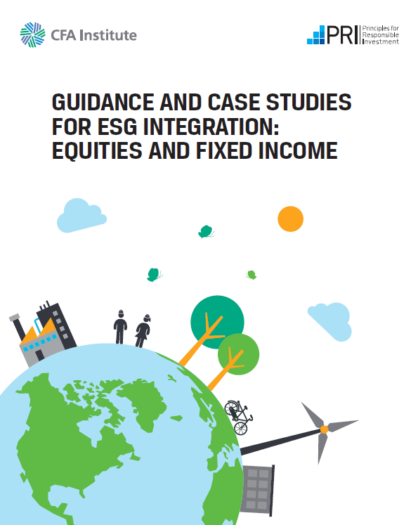
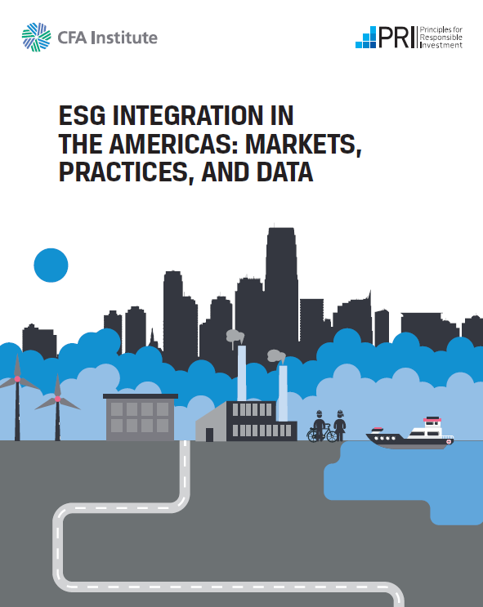
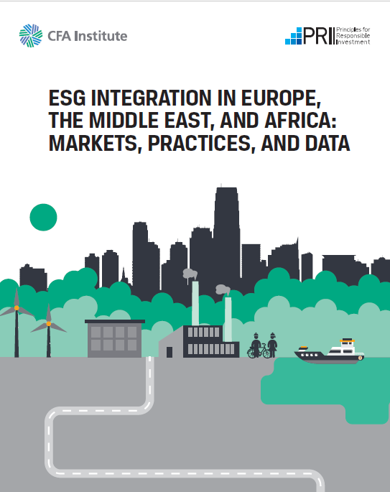
Overview
In 2017, CFA Institute and Principles for Responsible Investment (PRI) set out to create a best-practice report and three regional reports to help investors understand how they can better integrate ESG factors into their equity, corporate bond, and sovereign debt portfolios
The best-practice and Americas reports were released in September 2018. The EMEA report has just been released. APAC will be released soon.
ESG Integration in Asia Pacific (APAC): Markets, Practices, and Data
Q2 2019
Notes:
NOTES
Portfolio managers and analysts are increasingly incorporating ESG factors into their investment analyses and processes.
However, ESG integration remains in its relative infancy, with investors and analysts calling for more guidance on exactly “how” they can “do ESG” and integrate ESG data into their analysis.
In 2017, CFA Institute and Principles for Responsible Investment (PRI) set out to create a best-practice report (Guidance and Case Studies for ESG Integration: Equities and Fixed Income) and three regional reports [one for the Americas (AMER), one for Asia Pacific (APAC), and one for Europe, the Middle East, and Africa (EMEA)] to help investors understand how they can better integrate ESG factors into their equity, corporate bond, and sovereign debt portfolios.
The best-practice and Americas reports were released in September 2018. The best-practice report contains guidance on ESG integration in equity and fixed-income investments and contains 33 case studies on how ESG integration is “done” by leading practitioners. The Americas report focuses on the current state of ESG integration in the Americas.
Other regional reports will focus on the EMEA and APAC regions (to be released in Q1 2019).

Slide 3
Why is this important for Russian companies?
CSR – Companies : ESG - Investors
SRI – Socially Responsible Investing
CSR – Corporate Social Responsibility
ESG – Environment, Social Governance

Slide 4
Examples of ESG Issues
Environmental Issues | Social Issues | Governance Issues
■ Climate change and carbon emissions | ■ Customer satisfaction | ■ Board composition
■ Air and water pollution | ■ Data protection / privacy | ■ Audit committee structure
■ Biodiversity | ■ Labour Standards | ■ Bribery and corruption
■ Deforestation | ■ Gender and diversity | ■ Executive compensation
■ Energy efficiency | ■ Employee engagement | ■ Lobbying
■ Waste management | ■ Community relations | ■ Political contributions
■ Water scarcity | ■ Human rights | ■ Whistleblower schemes

Slide 5
Does ESG have an impact on Share Prices?
 | Canada |  |  | Russia |  |  | Europe
Percent | 2017 | by 2022 |  | 2017 | by 2022 |  | 2017 | by 2022
Governance | 52 | 54 |  | 81 | 85 |  | 60 | 69
Environmental | 30 | 48 |  | 7 | 26 |  | 24 | 54
Social | 26 | 41 |  | 11 | 30 |  | 24 | 46
Do investors look at ESG for risk or opportunity?
Governance | Canada | Russia | Europe
Risk | 48 | 70 | 62
Opportunity | 32 | 63 | 37

Slide 6
Regional findings: EMEA and Russia
There is no “one best way” to do ESG integration and no “silver bullet” to ESG integration.
Investors acknowledge that ESG data has come a long way, but advances in quality and comparability of data still have a long way to go.
It would be helpful for issuers and investors to agree upon a single ESG reporting standard that could streamline the data collection process and produce more quality data.
Governance is the ESG factor most investors are integrating into their process; Especially important in Russia
Environmental and social factors are gaining acceptance, from a low base – and Russia lower.
ESG integration is farther along in the equity world than in fixed income.
Portfolio managers and analysts are more frequently integrating ESG into the investment process, but rarely adjusting their models based on ESG data.
The main drivers of ESG integration are risk management and client demand. Globally and in Russia.
The main barriers to ESG integration are a limited understanding of ESG issues and a lack of comparable ESG data. In Russia, lack of regulatory involvement.
Many participants were concerned that ESG mutual funds and ETFs offered to investors may be driven by marketing decisions and may not be true ESG investment products.

Slide 7
Is ESG about Value or Values?
Value – how does ESG affect share and bond prices?
Will ESG factors improve in the nearest future?
Will investors see value; i.e., an increase in share prices?
Determines the availability of new capital funding for the company
Values – how does the company ‘want’ to act with respect to its social community and the environment?
Governance values are mostly about shareholder value and rights, especially treatment of minority shareholders;

Slide 8
Drivers of ESG integration in selected global capital markets
Equities
Canada
Risk 63%
Client demand 51%
Russia
Risk 56%
Client demand 41%

Slide 9
Barriers to ESG integration in selected global capital markets
Equities
Russia
Culture 52%
Data 37%
Client demand 37%
Canada
Understanding 54% Data 36%
Performance 31%

Slide 10
Key ideas for Russian companies
There is no right answer
Perfect isn’t available, be honest about your values and how you will implement them
Progress is more important than being there.
Governance is critical now in Russia
Board composition
Dividend policy (and consistency)
Corporate corruption – and diversion of value from shareholders
Minority shareholders rights to profit & dividends
Protection against adverse corporate action

Slide 11
Thank you
Neil Withers
Chairman, CFA Russia
nwithers@cfarussia.ru
This presentation is being provided to you by PRI Association (“the PRI”) and its subsidiaries for information purposes only. The presentation is incomplete without reference to, and should be viewed solely in conjunction with, the oral briefing provided by the PRI. No reliance may be placed on its accuracy or completeness. Neither the presentation, nor any of its contents, may be reproduced, or used for any other purpose, without the prior written consent of the PRI. PRI Association is incorporated in England & Wales, registered number 7207947 and registered at 25 Camperdown Street, London E1 8DZ.

